Slide 1
Identifying Risky Loans in Lending Club Data
By Neil Oza

Slide 2
Background/Proposal
Lending Club is an online lending platform which allows for peer to peer lending
Lending Club published an anonymized version of its loan data on Kaggle. The data contains information such as loan amounts, loan length, interest rate, borrower’s income, borrower FICO score, loan status, etc.
This data can help predict future loan defaults, and thereby help lenders work out payment plans with debtors and manage the risk of their portfolios
In this analysis,I will use machine learning to identify current loan with a high risk of default in the near future

Slide 3
Goals
Survey Lending Club’s Loan Dataset. Visualize the data in its columns and prepare the data for machine learning
Use the data to train machine learning algorithms that predict the status of loans (‘current’, ‘default’). Use validation methods and parameter tuning to identify the best model to deploy on the dataset
Interpret the results from the best model to determine the effectiveness of machine learning on this problem. Identify useful insights that can be derived from the algorithms predictions

Slide 4
Tools for the Job
Jupyter Notebook
Anaconda 3.7
Python Packages: pandas, numpy, scikit-learn, scikit-plot, matplotlib

Slide 5
Gathering the data
Lending Club posted anonymized versions of its loan data to kaggle alongside a data dictionary for the dataset. I downloaded the data as a csv downloaded the dictionary as an .xlsx file
I opened a Jupyter Notebook and used pandas to import the csv as a pandas dataframe. I took a look at the data. It was roughly 2.5 million rows by 150 columns
The data dictionary contained information about the columns in the dataset. I read tjrough the file to gain an understanding of the relationships between the features. Once done, I was ready to perform EDA to identify the features best suited for machine learning based prediction

Slide 6
EDA Introduction
EDA, or Elementary Data Analysis, is the process of using data visualization and data wrangling techniques to gain a better understanding of the data available and to prepare it for simple future use. The goals for this EDA are
Identify the target variable for the analysis. Identify the distribution of its values and identify values of interest within the feature
Create visualizations summarizing the distributions of features in the dataset. Use the visualizations and knowledge from the data dictionary to identify columns to drop
Sample the data to create a featureset and target variable to train the machine learning models. Encode the features as necessary
To begin, I will take a look at the target variable

Slide 7
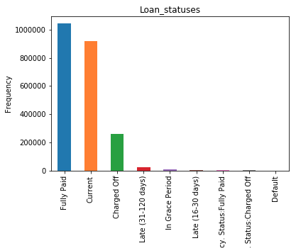
Identifying and Understanding the Target Variable
This analysis intends to use information on past loan defaults to predict future loan defaults. The column loan_status contains information on the status of loans, so it indicates which loans are fully paid, being paid as agreed, or defaulting.
To get a better understanding of the column, I used pandas value_counts function and plotted the results as a bar graph (right)

Slide 8
Loan_status in depth
The values in loan_status fall into three general categories: fully paid loans, current loans, and defaulted loans (in this dataset defaulted loans are referred to as Charged Off). Defaulted loans is the smallest category
The loans that are fully paid are not particularly useful for this analysis. This is because we want to identify current loans at high risk of default, and fully paid loans have no risk of default
Fully Paid 1041952
Current 919695
Charged Off 261655
Late (31-120 days) 21897
In Grace Period 8952
Late (16-30 days) 3737
Does not meet the credit policy. Status:Fully Paid 1988
Does not meet the credit policy. Status:Charged Off 761
Default 31

Slide 9
Loan_status in depth cont.
In addition, loans that have been fully paid may not have been updated for a while. Using that data would be mixing old and new data which is unwise unless you know of all changes in ata collection between those time frames. For this and the previous reason, loans that were fully paid will not be used while training machine learning models.
For the purposes of this analysis, the values late (15-30 Days), late (15-180 Days), charged off, and default are all considered delinquent/defaulted loans while the values current and in grace period are considered current loans. This allows us to use 2 category classifiers.

Slide 10
Visualizing the Columns
Now that we have identified the target variable, we need to create a featureset to hlp the machine learning algorithms predict the target variable. In order for a column to be suitable for the featureset, it cannot have numbers of null values, cannot be highly correlated with the target variable, and, in the case of categorical variables, must be encodeable

Slide 11
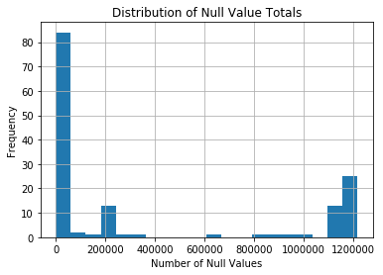
Null Values by Column
Machine Learning Algorithms do not handle null values particularly well. To mitigate this problem, columns with large numbers of null values are omitted from featuresets
As seen on the histogram on the right, most columns have no or few null values, though a noticeable subset have mostly null values
The column with ~600,000 null values is mths_since_last_delinq. It will be dropped along all columns with even more null values

Slide 12
Visualizing the Data in each Column
After dropping all columns with large numbers of null values, I wanted to visualize the distributions of the remaining columns. Inspecting the dataframe, the remaining columns were numeric or object types. When visualizing, I want to compare distributions of each variable for loans that are in the default category and those in the current category
Numeric columns were plotted as histograms while object columns were plotted as bar plots if the column contained less than 10 total possible values. If the column contained more than 10 values it is not plotted and the column is noted

Slide 13
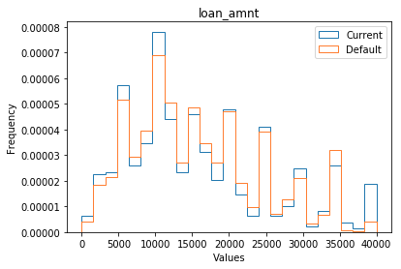
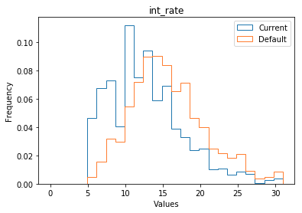
Example Histograms

Slide 14
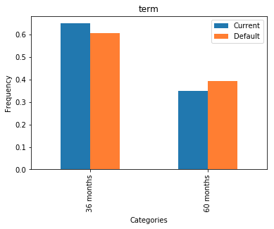
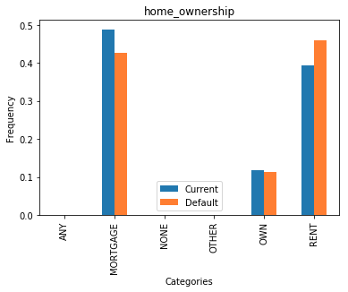
Example Bar Plots

Slide 15
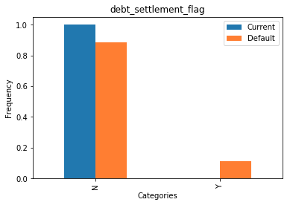
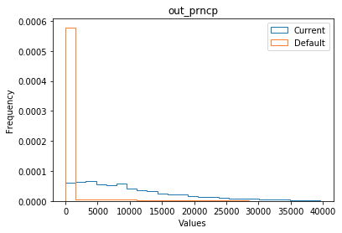
Plots of Problematic Features

Slide 16
Visualizing the Columns
Using the Bar Plots and Histograms similar to the ones on the previous slides, I was able to compare the distributions of column values for the Current and Default categories
Most columns had minor variations in values between the two categories. However, several had significantly different distributions based on category
For example, out_prncp is almost always a small numbr when the loan_status is default, while taking on much more varied values when current. Similarly, the debt settlement flag only takes on the value ‘y’ when in default. Columns like these should and will be dropped from the dataset to prevent data leakage and to ensure training of a sound model

Slide 17
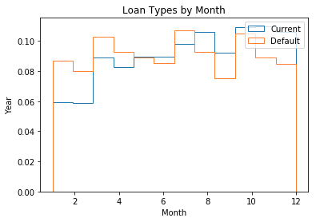
Columns that could not be plotted
There were a handful of columns that contained non-numeric data and could not be plotted because they took on too many possible values. For example columns such as emp_title and issue_d could not be plotted because they took on so many possible values. Several of these columns are datetime values. Looking over the columns in question, I became interested if there was seasonality in defaults with respect to loan issue month. There was, so the column was encoded and added to the dataset

Slide 18
Table of all Columns Used in Analysis
funded_amnt | tot_cur_bal | mths_since_recent_bc | inq_last_6mths | total_cu_tl | num_tl_90g_dpd_24m
funded_amnt_inv | open_acc_6m | mths_since_recent_inq | mths_since_last_delinq | inq_last_12m | num_tl_op_past_12m
term | open_act_il | num_accts_ever_120_pd | open_acc | acc_open_past_24mths | pct_tl_nvr_dlq
int_rate | open_il_12m | num_actv_bc_tl | pub_rec | avg_cur_bal | percent_bc_gt_75
installment | open_il_24m | num_actv_rev_tl | revol_bal | bc_open_to_buy | pub_rec_bankruptcies
grade | mths_since_rcnt_il | num_bc_sats | revol_util | bc_util | tax_liens
sub_grade | total_bal_il | num_bc_tl | total_acc | chargeoff_within_12_mths | tot_hi_cred_lim
emp_length | il_util | num_il_tl | initial_list_status | delinq_amnt | total_bal_ex_mort
home_ownership | open_rv_12m | num_op_rev_tl | collections_12_mths_ex_med | mo_sin_old_il_acct | total_bc_limit
annual_inc | open_rv_24m | num_rev_accts | policy_code | mo_sin_old_rev_tl_op | total_il_high_credit_limit
verification_status | max_bal_bc | num_rev_tl_bal_gt_0 | application_type | mo_sin_rcnt_rev_tl_op | hardship_flag
purpose | all_util | num_sats | acc_now_delinq | mo_sin_rcnt_tl | disbursement_method
dti | total_rev_hi_lim | num_tl_120dpd_2m | tot_coll_amt | mort_acc | month_issued
delinq_2yrs | inq_fi | num_tl_30dpd

Slide 19
EDA Conclusion
I Identified the target variable, I visualized the various features, and I selected the features and records most suitable for this analysis
Approximately 60 columns and 1.2 miillion rows were removed from the dataset. The new dimensions of the dataset were 1.3 million rows by 86 columns. This is still a lot of data
Next I will take this refined dataset and use it to Create a train and test set for the analysis. I will also initialize, train, and tune several machine learning models and compare their outputs

Slide 20
Machine Learning
Machine Learning is the process of using A.I. Algorithms to learn and make predictions based off of available data
For this analysis, I will try to predict a loan’s status using the featureset created during EDA
I will train and tune logistic regression, naive bayes classifier, SVC, random forest, and xgboost algorithms
I will use several metrics in order to compare the effectiveness of the various algorithms. After looking over the metrics I will select a best model
I will briefly go over the algorithms used in the next few slides

Slide 21
Logistic Regression
Logistic Regression is a classification algorithm that uses a linear equation of features to predict the target variable. It requires regularization through techniques such as ridge, lasso, and elastic net. It performs best when the features are linearly independent, when features are normalized, and when relationships are simple enough to model linearly. Logistic Regression algorithms struggle with complicated relationships between the target and featureset, and also struggle with partially correlated features

Slide 22
Naive Bayes Classifier
Naive Bayes Classifier uses Bayes Theorem and assumes independence among all features in order to predict the target variable. The algorithm requires a smoothing parameter to help handle previously unseen values. The algorithm is very simple, and is usually outperformed by more sophisticated models.

Slide 23
Support Vector Classifier
Support Vector Machines classify data by creating a hyperplane that serves as a border between categories. Support Vector Machines have two major hyperparameters:C and gamma. C is a regularization parameter and gamma influences the importance of points far away from the decision boundary when creating the decision boundary

Slide 24
Random Forest
Random Forest Classifier uses multiple decision trees to classify a new data point. Each tree in the random forest is trained independently on a subset of the data. This causes each tree to split the data slightly differently, so when presented with new data the individual trees reach slightly different conclusions. Random forests return the average of all of the trees as the classification.

Slide 25
XGBoost
XGBoost uses a decision tree to create an algorithm modeling the data. Then it identifies which datapoints the algorithm misclassified,gives them added weight, and then creates a new decision tree which handles the previously missed values better. XGBoost has two hyperparameters: learning rate and max depth.

Slide 26
Machine Learning Best Practices
Now that we have an overview of the algorithms, I will go over the precise process i will use to train and evaluate them.
For starters, the algorithms used in this analysis only require 10,000 or so samples to train. In order to keep evaluation times reasonable, I will only sample 20,000 of the 1.3 million available loans for training and testing.
Scikit-learn machine learning algorithms require entirely numeric values to function properly. To accomodate this, I will encode all categorical variables using one hot encoding
In order to evaluate the data effectively, I will split the sample data into training and test sets. I will use the train set to train the data and the test set to evaluate the models performance

Slide 27
Training and comparing out of box models
I use precision, recall, accuracy, f1 score, and roc-auc values as my evaluation metrics for the algorithms. I also use a precision-recall curve, roc-curve,lift curve, gains chart, and a distribution of predicted values to visualize model performance.
I train the various algorithms on the data and tune their hyperparameters using cross validation. I then created and compared the evaluation metrics for the various algorithms to determine the best performer
For reference, the evaluation metrics for the tuned Random Forest and tuned XGBoost are reproduced on the folowwing slides

Slide 28
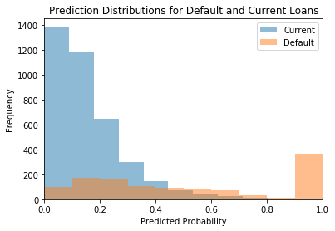
Evaluation Metrics/ Plots for Random Forest
the Precision is 0.863013698630137
the Recall is 0.47368421052631576
the f1 score is 0.6116504854368932
the roc-auc score is 0.8392448822995344
the accuracy score is 0.856

Slide 29
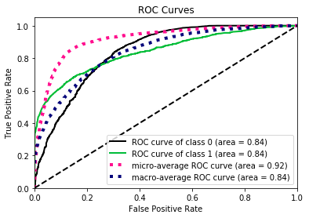
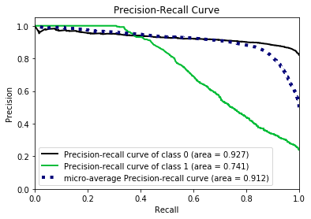
Evaluation Plots for Random Forest cont.

Slide 30
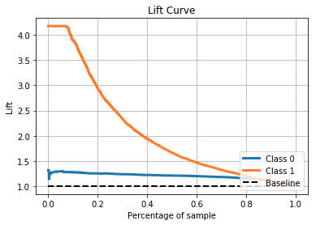
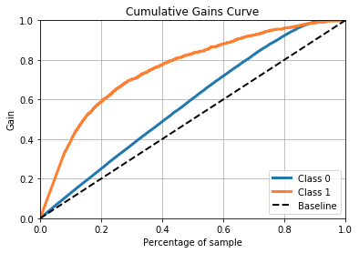
Evaluation Plots for Random Forest cont.

Slide 31
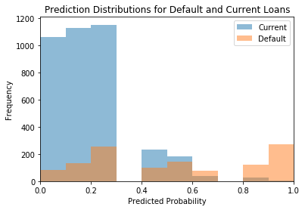
Evaluation Metrics/Plots for XGBoost
the Precision is 0.7958883994126285
the Recall is 0.45971162001696353
the f1 score is 0.5827956989247312
the roc-auc score is 0.8032537033078436
the accuracy score is 0.8448
The number of loans predicted to default is 681 out of a test size of 5000

Slide 32
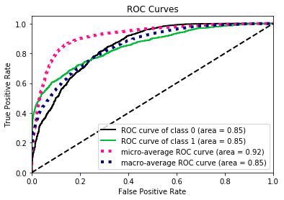
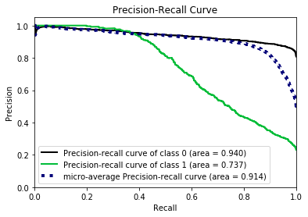
Evaluation Metrics for XGBoost cont.

Slide 33


Evaluation Metrics for XGBoost cont.

Slide 34
Results
XGBoost was the best performing algorithm after hyperparameter tuning
The hyperparameters tuned were max_depth=5, learning_rate=.01.
The XGBoost Classifier had high precision (~.80) but middling recall (~.50). This suggests the model will usually be correct when it predicts a default, but it fails to catch roughly 50% of default cases. This suggests that there are important factors that affect default rate that are not captured in the data
Since the XGBoost Classifier has such high precision, it is likely that current loans misclassified as default are at high risk of default in the near future. Lenders can use this algorithm to identify these borrowers and make sure everything is going on track

Slide 35
Conclusions
I successfully downloaded and visualized the data contained in Lending Club’s Loan Data. I identified columns with useful information, columns with too many null values, and columns that were useful for machine learning purposes. I also created bar plots and histograms to visualize the distributions of the many features in the dataset
I trained and tuned five machine learning models to identify defaulted loans from current loans in the dataset. I used various evaluation metrics to compare the effectiveness of the algorithms and i used the appropriate preprocessing techniques to ensure valid results
I identified Random Forest as the best performing Algorithm. The algorithm suggested that some of the variation in the loan status is unexplained by the features available. Since the model had high precision, lenders can use the model to identify current loans at high risk of default
Special thanks to Nikol

